Slide 1
1
Project Title: Design and Implementation of a Mobile App for QoE Data Collection
Task 5: UI Design and Implementation
Course Code and Title: CEF440 Internet Programming and Mobile Programming
Course Instructor: Dr. Nkemeni Valery
Presented by Group13

Slide 2
2
Presentation Overview
Introduction
UI Design Colors and Typography used
Pages Designed
i. Mobile Network Subscriber Pages
ii. Mobile Network Operator pages
iii. Admin Pages
- Demo
Conclusion

Slide 3
3
Introduction
This presentation gives an overall description of the UI design and Implementation of a QoE application used to collect user’s feedback data and network metrics data from their mobile phones.

Slide 4
4
UI Design Colors and Typography Used
Colors Used
Blue : Trust, calmness and professionalism.
Red: urgency, passion.
White Background: Blends well with
Light Pink (For the Navigation Bar): Compassion
Typography Used
Roboto (most often used for Mobile Apps)
Manrope (visually appealing)

Slide 5
5
Design Phase
Mobile Network Subscriber Pages: Welcome Page, SignUp page, Login page, Permissions page, Network Metrics Page.
Mobile Network Operator Pages: Welcome page, Request Access Page, Login Page, Unified feedback analytics page, Feedback Insights page. System Admin Pages: System Admin Page, Review and Verify Request Page, View Document Page

Slide 6
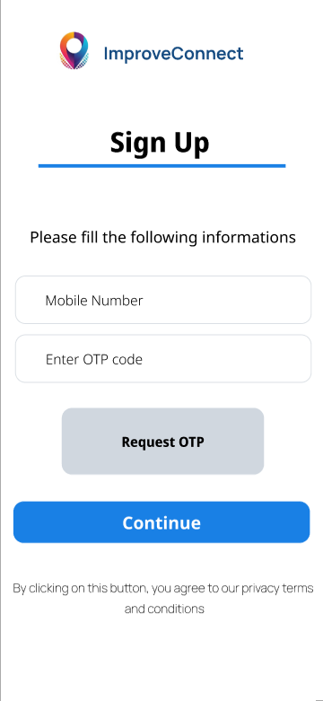
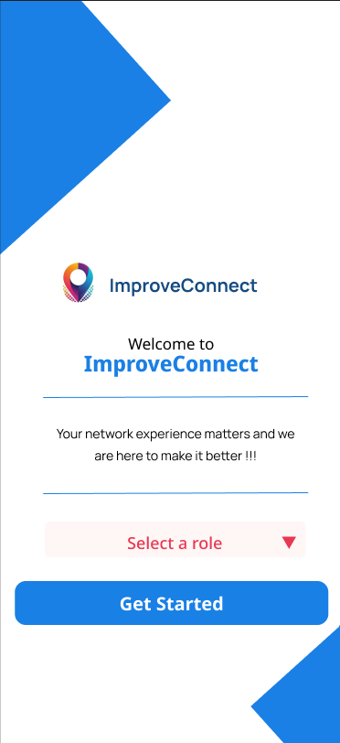
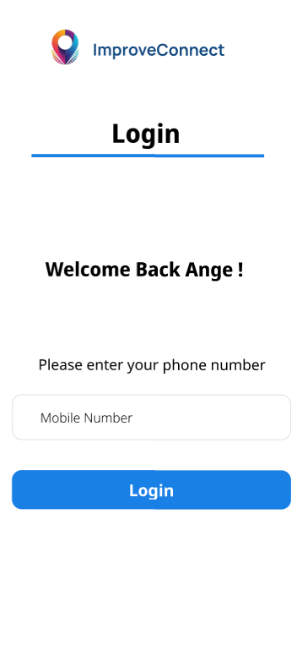
6
Mobile Network Subscriber Pages (1)

Slide 7
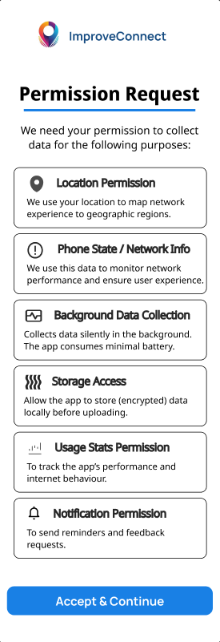
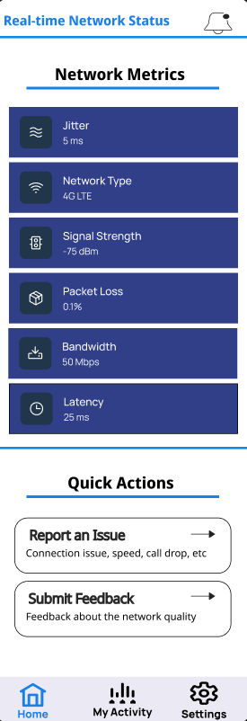
7
Mobile Network Subscriber Pages (2)

Slide 8
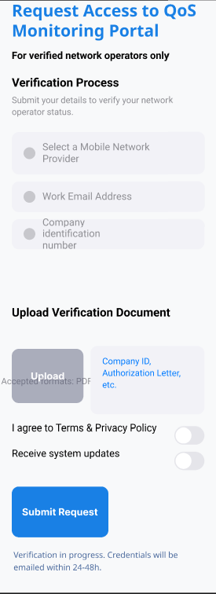
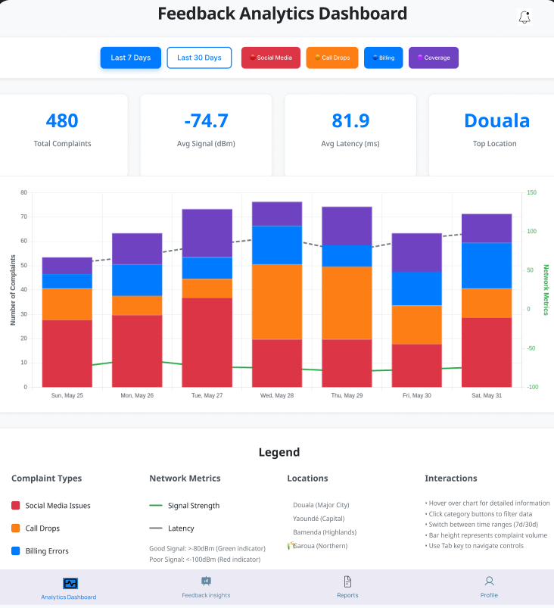
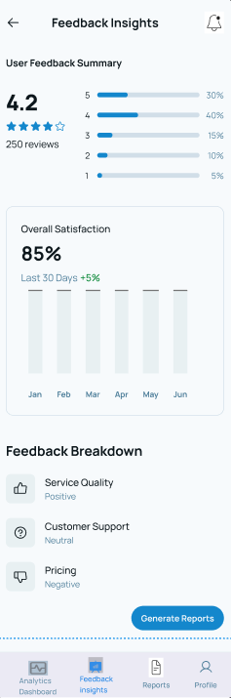
8
Mobile Network Operator Pages

Slide 9
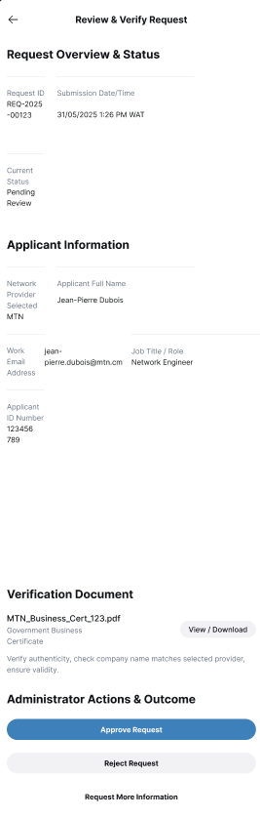
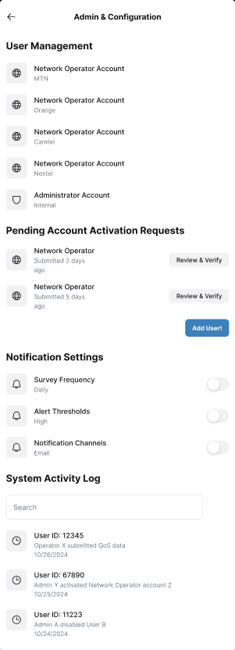
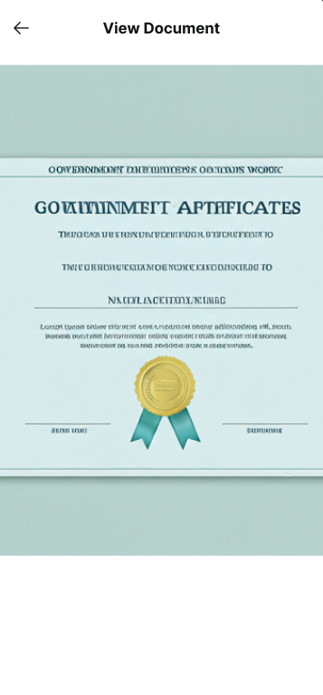
9
System Admin Pages

Slide 10
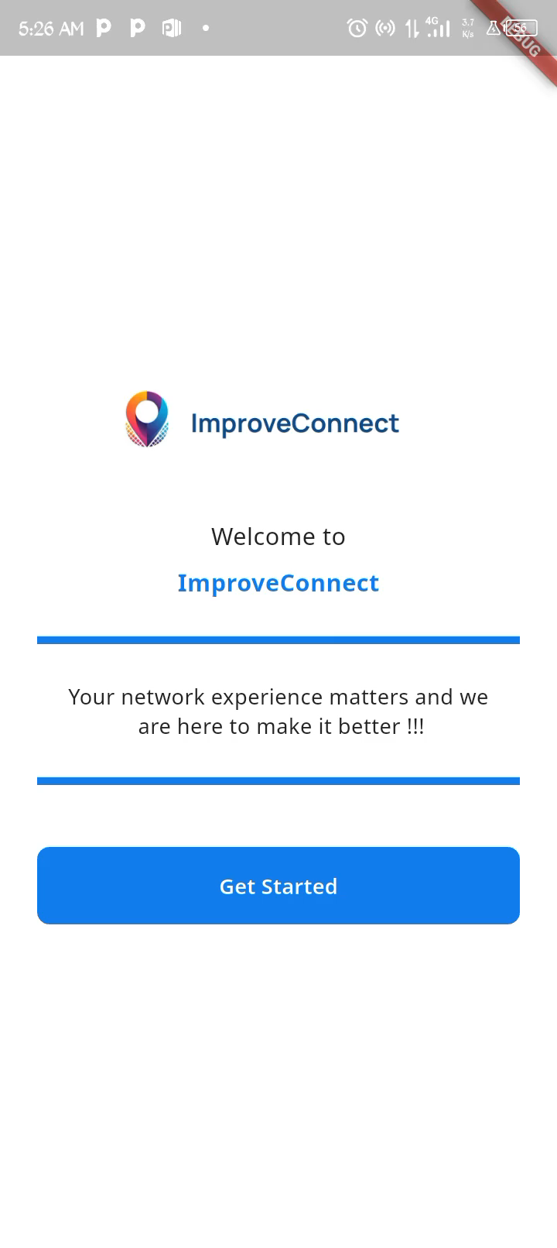
Demo (1) – Mobile Network Subscriber Implemented Pages
10

Slide 11
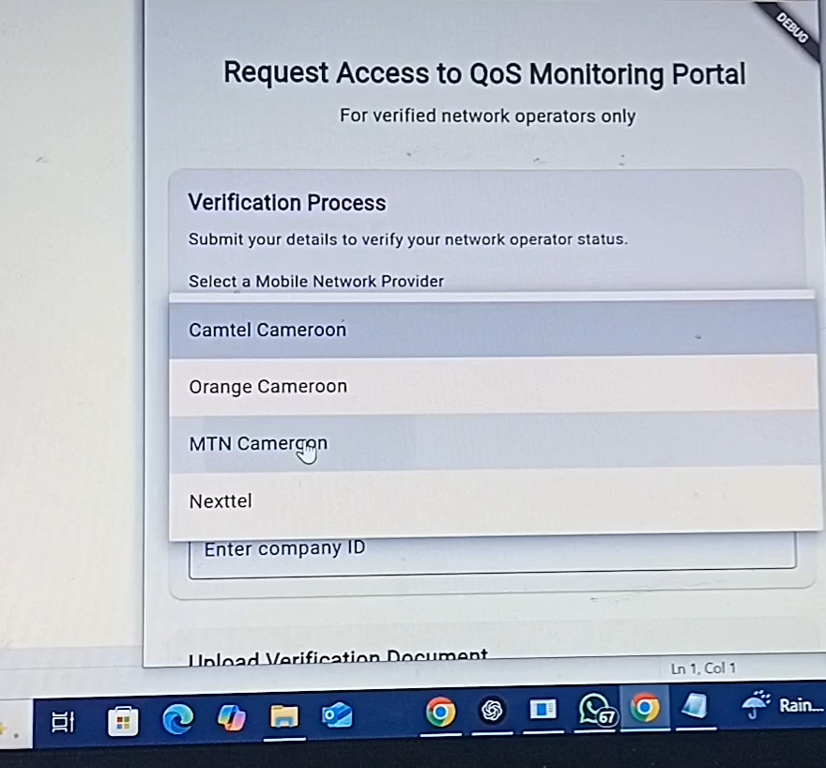
11
Demo (2) – Mobile Operator Implemented Pages

Slide 12
12
Conclusion
Overall, we successfully the network subscriber and network operator pages
We are still left with some pages (System Admin pages) to implement.

Slide 13
13
Thank you!

